Slide 1
FAKE PRODUCT REVIEW MONITORING Presented by- Anushka Kanaujia (1805210010) Astha Sachan(1805210015) Prateeksha Tiwari(1805210037) Supervisor-Prof. Maheshwari Tripathi Co-Supervisor-Mr. Mahima Shanker Pandey INSTITUTE OF ENGINEERING AND TECHNOLOGY, LUCKNOW

Slide 2
INTRODUCTION
Reviews on online websites play a vital role in sales of the product as before buying people try to get all the pros and cons of the product.
The scope and need of online markets and e-commerce platforms are on the rise.
The amount of feedbacks for products are present in detail for users to analyze the product they are buying.
Users sometime bombard the review section with extreme comments which can work in favor or against the product.
This project aims to take care of factitious review.

Slide 3
RELATED WORKS
1.Detection of spams using ratings behavior [1]
2. Spotting a group of fake reviewers [2]
3. Online reviews manipulation[3]
4.A Review on fake product review detection and removal techniques[4]

Slide 4
Detection of spams using ratings behavior [1](2010) | - Checked rating behaviour of the product. - Unnecessary bad or good reviews were eliminated
Spotting a group of fake reviewers [2](2012) | - Spotted group of spammers that are posting same reviews multiple time using same IP address
Online reviews manipulation[3](2015) | - To find out the genuine review graphics analysis was done, but as each user does not post picture with review this was not very effective.
A Review on fake product review detection and removal techniques[4](2021) | - Mentions the six ways to treat the fake reviews - Discuss which one of six is the best
Fake Product Review Monitoring(our Project) (2022) | - Our project incorporate all the six steps in a well organized manner so that the reviews at the end will mostly be genuine.

Slide 5
According to Oberlo statistics,
Nearly Nine out of Ten customers read reviews before making a purchase on popular shopping websites

Slide 6
STATISTICS
79%
of shoppers say that they trust
online reviews as much as
personal recommendations
54.7%
of consumers read at least four reviews before buying a product.
1
2
82%
have read a fake review in
the last year
52%
of consumers believe fake product reviews have become a norm of the industry
3
4

Slide 7
BIG CONCEPT
6 Steps to filter out fake reviews and give the results with high accuracy

Slide 8
FEATURES
Review which have dual view
STEP 1
Reviews in which same user promoting or demoting a brand
ISTEP 2
Reviews in which same IP address is promoting or demoting a brand
ISTEP 3
Reviews posted as flood by same user
STEP 4
Similar reviews posted in same time frame
STEP 5
Meaning less texts in reviews using LSA
STEP 6

Slide 9
CODE EXCERPTS

Slide 10

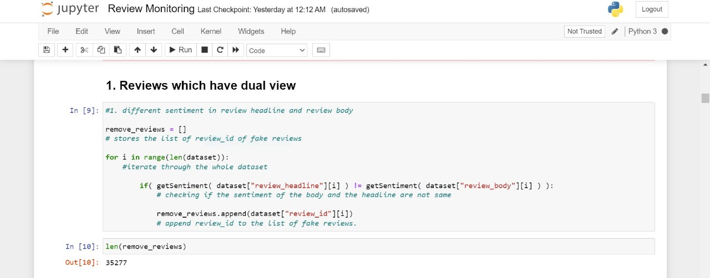
Want big impact?
USE BIG IMAGE.

Slide 11

This is how our website looks!
Users can add reviews about the different places in the review section

Slide 12
DISADVANTAGES OF EXISTING SYSTEM
User are not able to find out whether the review is genuine or fake.
If the social media optimization team uses different IP address to send the same review, system fail to track the fake review.
Brands can use their resources to wrongly increase the rating of their particular products.
Same user can write multiple reviews from different accounts.

Slide 13
METHODOLOGY
Reviews by customers on a product will act as our data on which methods will be applied.
For filtering the fake reviews from genuine one mining method will be carried out.
Apply analysis algorithm to make insightful data analysis
There are many mining methods like:
Text Mining
Mining opinions and sentiments analysis
Natural language processing or NLP

Slide 14
92,933
Reviews used in our dataset!

Slide 15
ADVANTAGES
User gets genuine reviews about the product.
Better filtering which ensures minimum fake reviews.
User can spend money on products which have genuine reviews.
Companies can gain more user trust by keeping more genuine reviews.
Fraudulent cases can be detected and taken care of.

Slide 16
92,933
38,752
82%
Total reviews
Fake reviews
Accuracy

Slide 17
FUTURE SCOPE
Finding the opinion spam from huge amount of unstructured data has become an important research problem. This project aims to provide further improvement.
More future work and knowledge is needed on further improving the performance of the opinion spam analysis.
In the future it will further investigate different kinds of features to make more accurate predictions and apply them in various shopping website.
The project is aimed to be applied in various existing shopping sites and apps , which currently does not have such technologies.

Slide 18
ROADMAP
List products on the website, include the backend part and database to store user reviews
Inclusion of sentimental analysis, latent semantic analysis, and content similarity.
Worked on the idea and synopsis of the project
1
3
5
2
4
6
assessed various methodologies through the published research papers
Detect multiple reviews submitted through the same IP addresses
Final testing of system , further enhancements on accuracy

Slide 19
REFERENCES
[1]Detecting product review spammers,2010-Ee-Peng Lim(School of Information Systems Singapore Management University)
[2] Manipulation of online reviews: An analysis of ratings, readability, and sentiments Decision Support Systems, 2012 -Noi Sian Koh(Singapore Management University, Singapore)
[3]Spotting Fake Reviewers using Product Review Graph,2015-Zhou Wang(School of Information Science and Engineering, Shenyang Ligong University, Shenyang , China
[4] A Review on fake product review detection and removal techniques,2021- Rutuja B. Ardak , Prof. Girish S Thakre ( Sipna C.O.E.T, Amravati, India)

Slide 20
[4] https://towardsdatascience.com/sentiment-analysis-concept-analysis-and-applications-6c94d6f58c17
[5] https://www.aviso.com/blog/sentiment-analysis-using-nlp/
[6] https://kavita-ganesan.com/what-is-text-similarity/
[7]https://cfm.ehu.es/ricardo/docs/python/Learning_Python.pf
[8] https://www.oberlo.in/blog/online-review-statistics

Slide 21
THANK YOU

